Slide 1

PARALLEL PROGRAMMING...
Copyright 2023 Patrick Lemoine. All rights reserved.

Slide 2

Parallel Programming: Overview
SESSION 3/6
GOAL
Programming Interface for parallel computing
OpenMP (Open Multi-Processing)

Slide 3
Programming interface for parallel computing
병렬 컴퓨팅을 위한 프로그래밍 인터페이스

Slide 4



OpenMP (Open Multi-Processing)

Slide 5
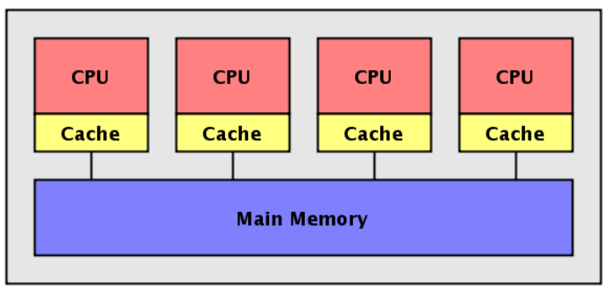

OpenMP (Open Multi-Processing)
OpenMP is a programming interface for parallel computing on shared memory architecture.
A set of compiler directives and a runtime library
#pragma omp parallel num_threads(4)
#include <omp.h>
It allows you to manage:
the creation of light processes
the sharing of work between these lightweight processes
synchronizations (explicit or implicit) between all light processes
the status of the variables (private or shared).

Slide 6
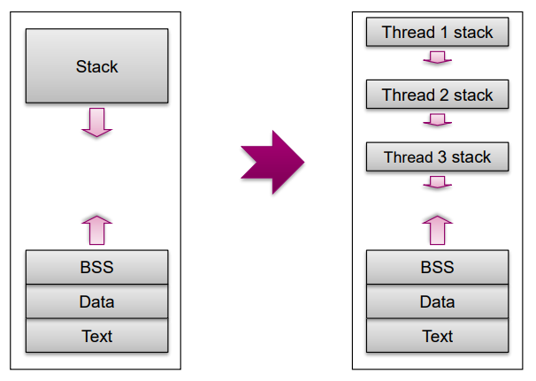
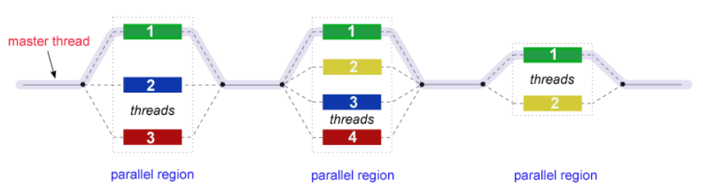
OpenMP (Open Multi-Processing)
OpenMP is based on Fork/Join model
When program starts, one Master thread is created
Master thread executes sequential portions of the program
At the beginning of parallel region, master thread forks new threads
All the threads together now forms a “team”
At the end of the parallel region, the forked threads die !

Slide 7


OpenMP (Open Multi-Processing)
The OpenMP API consists of
compiler directives (for insertion into sequential Fortran/C/C++$code)
a few library routines
some environment variables
Advantages:
User-friendly
Incremental parallelization of a serial code
Possible to have a single source code for both serial and parallelized versions
Disadvantages:
Relatively limited user control
Most suitable for parallelizing loops (data parallelism)
Performance?

Slide 8
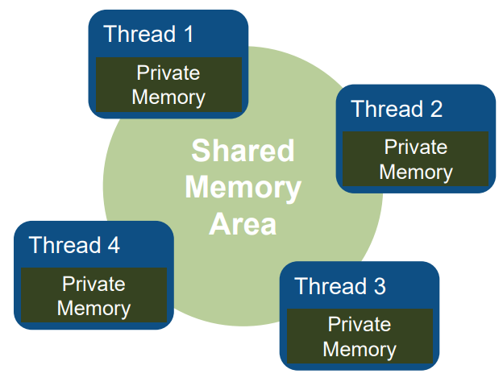
OpenMP (Open Multi-Processing)
What is a Shared-Memory Program?
One process that spawns multiple threads
Threads can communicate via shared memory
Read/Write to shared variables
Synchronization can be required!
OS decides how to schedule threads

Slide 9
OpenMP (Open Multi-Processing)
Shared memory model
Threads communicate by accessing shared variables.
The sharing is defined syntactically
Any variable that is seen by two or more threads is shared.
Any variable that is seen by one thread only is private.
Race conditions possible
Use synchronization to protect from conflicts.
Change how data is stored to minimize the synchronization.

Slide 10
OpenMP (Open Multi-Processing): Why ?
Multicore CPUs are everywhere:
Servers with over 100 cores today and more.
Even smartphone CPUs have 8 cores.
Multithreading, natural programming model
All processors share the same memory.
Threads in a process see same address space.
Many shared-memory algorithms developed.
Multithreading is hard
Lots of expertise necessary.
Deadlocks and race conditions.
Non-deterministic behavior makes it hard to debug.

Slide 11
OpenMP: Process and thread: whatis the difference ?
You need an existing process to create a thread.
Each process has at least one thread of execution.
A process has its own virtual memory space that cannot be accessed by other processes running on the same or on a different processor.
All threads created by a process share the virtual address space of that process.
They read and write to the same address space in memory.
They share the same process and user ids, file descriptors, and signal handlers.
They have their own program counter value and stack pointer, and can run independently on several processors.

Slide 12
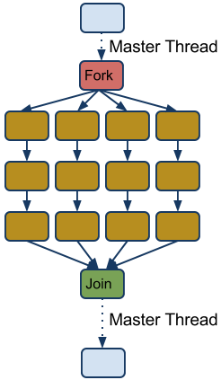
OpenMP: Terminology and behavior
OpenMP Team = Master + Worker
Parallel Region is a block of code executed by all threads simultaneously (has implicit barrier)
The master thread always has thread id 0 !
Parallel regions can be nested.
If clause can be used to guard the parallel region.

Slide 13




OpenMP: General Code Structure
#include <omp.h>
main ()
{
int var1, var2, var3;
//serial code
//start of a parallel region
#pragma omp parallel private(var1, var2) shared(var3)
{...}
//more serial code
{...}
//another parallel region
#pragma omp parallel
{…}
}

Slide 14
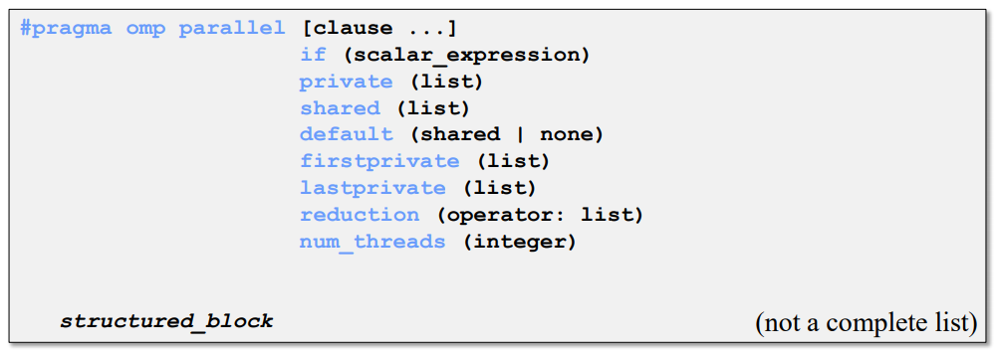
OpenMP: Constructs Parallel Region
Parallel region
Thread creates team, and becomes master (id 0).
All threads run code after.
Barrier at end of parallel section.

Slide 15
OpenMP: Parallel Clauses
Only execute in parallel.
Otherwise serial.
Data local to thread.
Value are not guaranted to be defined on exit (even if defined before)
No storage associated with original object
Use firstprivate and/or lastprivate clause to override
Variables in list are private.
Initialized with the value the variable had before entering the construct.
Only in for loops
Variables in list are private.
The thread that executes the sequentially last iteration updates the value of the variables in the list.

Slide 16
OpenMP: Parallel Clauses
Data is accessible by all threads in team.
All threads access same address space.
Improperly scoped variables are big source of OMP bugs
- Shared when should be private
- Race condition
Tip: Safest is to use default (none) and declare by hand.

Slide 17
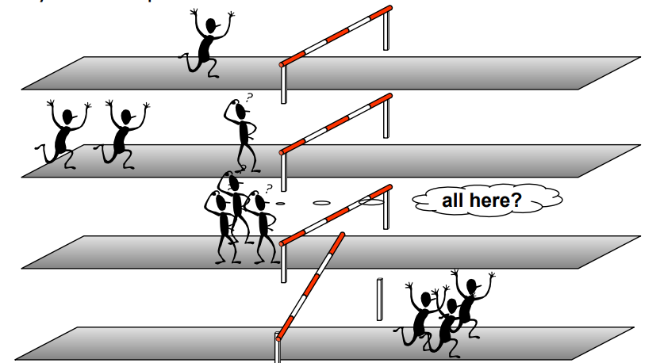
OpenMP: Barrier
When a thread reaches a barrier it only continues after all the threads in the same thread team have reached it.
Each barrier must be encountered by all threads in a team, or none at all
The sequence of work-sharing regions and barrier regions encountered must be same for all threads in team
Implicit barrier at the end of: do, parallel, single, workshare

Slide 18
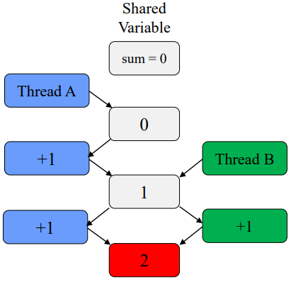
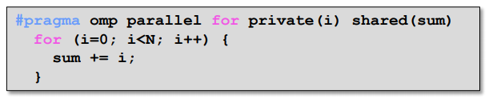
OpenMP: Caution Race Condition
When multiple threads simultaneously read/write
Multiple OMP solutions :
Reduction
Atomic
Critical
Should be 3!

Slide 19
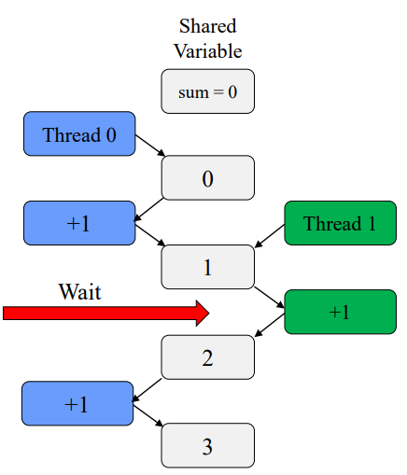
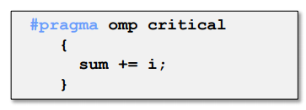
OpenMP: Critical Section
One solution: use critical
Only one tread at a time can execute a critical section
Downside ?
YES SLOOOOWWW
Overhead and serialization

Slide 20
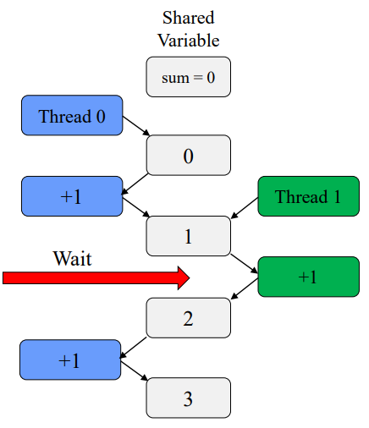
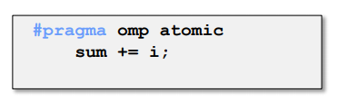
OpenMP: Atomic
Atomics like "mini" critical
Only one line
Certain limitations
Hardware controlled
Less overhead the critical

Slide 21
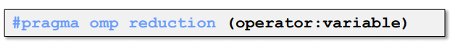
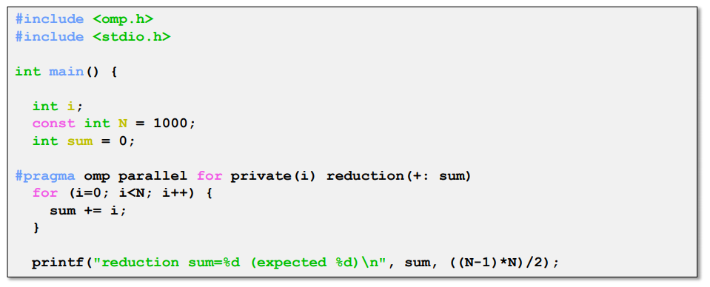
OpenMP: Reduction
Avoids race condition
Reduce variable must be shared
Makes variable private, then performs operator at end of loop
operator cannot be overloaded (c++)
One of: +,*,-,/ (and &,^,|,&&,||)
OpenMP 3.1: added min and max for c/c++

Slide 22
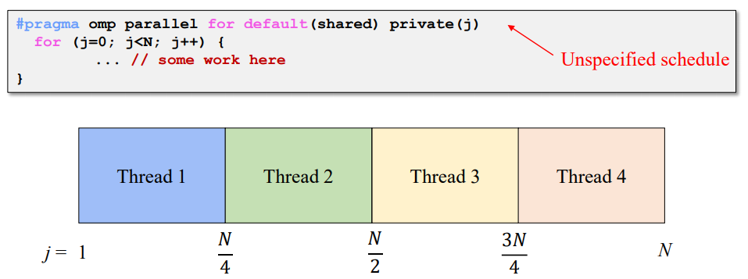
OpenMP: Scheduling omp for
How does a loop get split up ? In MPI, we have to do it manually!!!
If you do not tell what to do, the compiler decides
Usually compiler chooses "static" - chunks of N/p

Slide 23
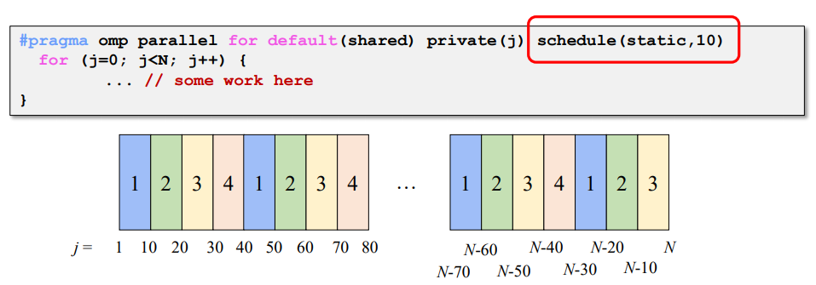
OpenMP: Static Scheduling
You can tell the compiler what size chunks to take ?
Keeps assigning chunks until done.
Chunk size that is not a multiple of the loop will results in thread with uneven numbers.

Slide 24
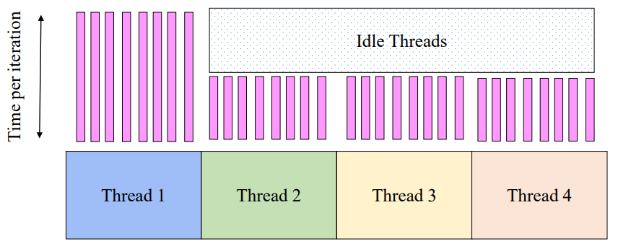
OpenMP: Problem with Static Scheduling
What happens if loop iterations do not take the same amount of time ?
Load imbalance

Slide 25
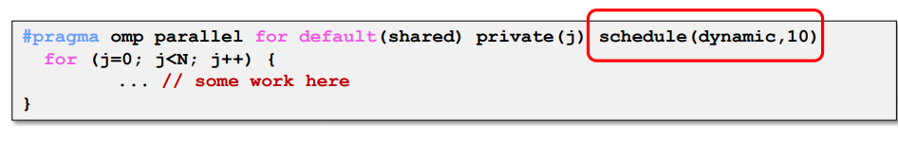
OpenMP: Dynamic Scheduling
Chunks are assigned on the fly, as threads become available.
When a thread finishes on chunk, it is assigned another
Caveat: higher overhead than static!

Slide 26
OpenMP: For Scheduling Recap
Scheduling types
Static
- Chunks of specified size assigned round-robin
Dynamic
- Chunks of specified size are assigned when thread finishes previous chunk
Guided
- Like dynamic, but chunks are exponentially decreasing
- Chunk will not be smaller than specified size
Runtime
- Type and chunk determined at runtime via environment variables

Slide 27
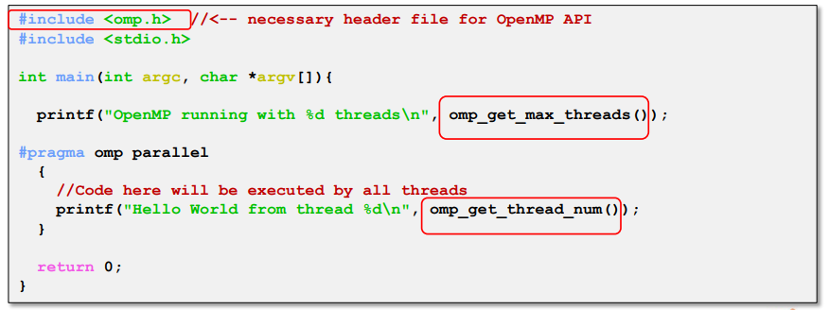
OpenMP: API
API for library calls that perform useful functions
Must include "omp:h"
Will not compile without OpenMP compiler support

Slide 28
OpenMP: API
Sets number of treads used in next parallel section
Overrides OMP_NUM_THREADS environment variable
Returns max possible (generally set by OMP_NUM_THREADS)
Returns number of threads currently in team
Returns thread id of calling thread
Between 0 and omp_get_num_threads-1
Returns number of seconds since some point
Use inpais time=(t2-t1)

Slide 29
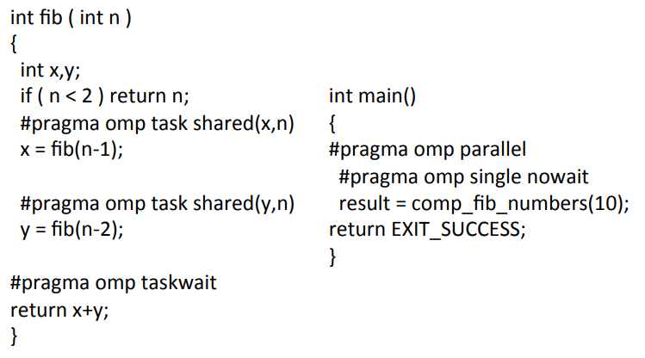
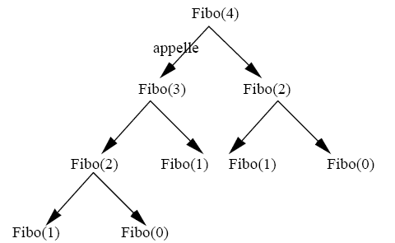
OpenMP: Example Fibonacci
fib(0) = 1
fib(1) = 1
fib(n) = fib(n-1) + fib(n-2)
avec n ∈ ℕ

Slide 30
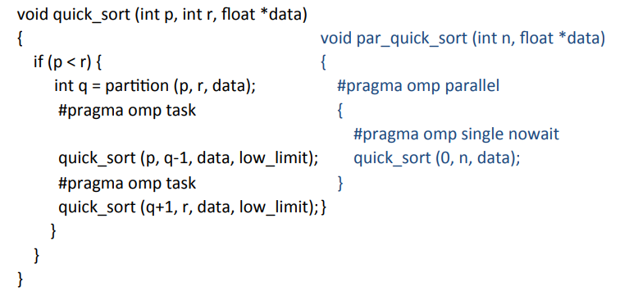

OpenMP: Example Quicksort

Slide 31
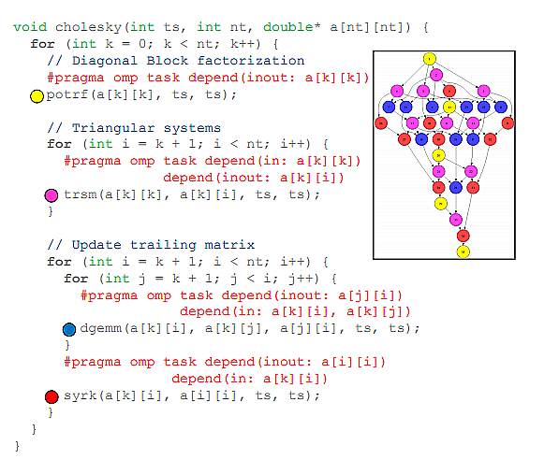
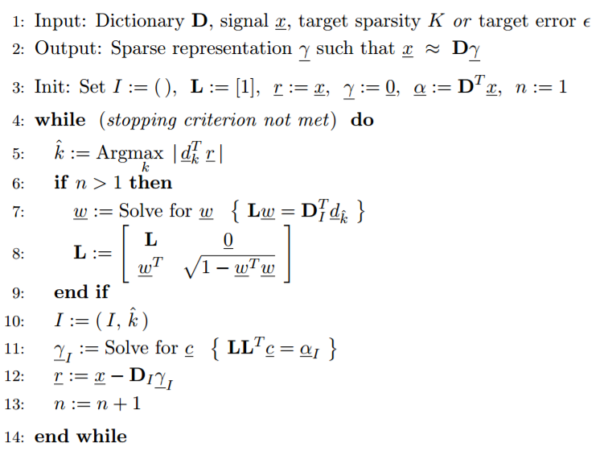
OpenMP: Example Cholesky Factorization
The Cholesky factorization, also known as Cholesky decomposition, is a process of breaking down of a Hermitian, positive-definite matrix into the product of a lower triangular matrix and its conjugate transpose, which is important for quick numerical solutions in linear algebra.

Slide 32
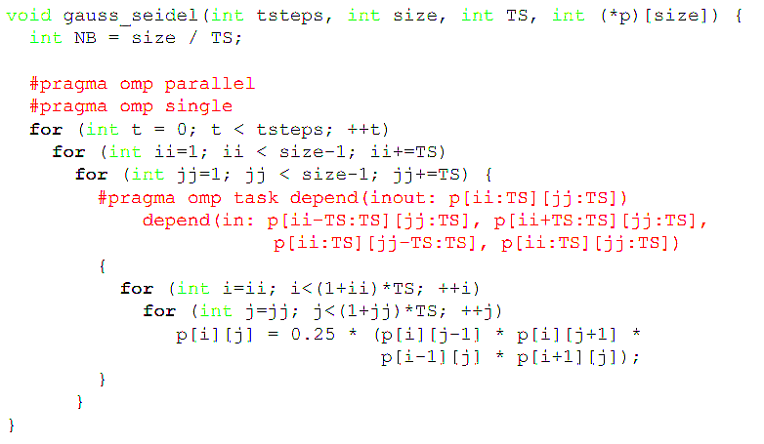
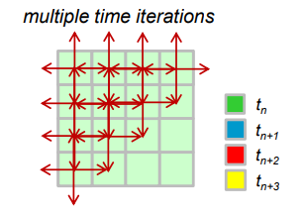
OpenMP: Example Gauss-Seidel
Gauss-Seidel Method is used to solve the linear system Equations. It is a method of iteration for solving n linear equation Ax=b with the unknown variables.

Slide 33
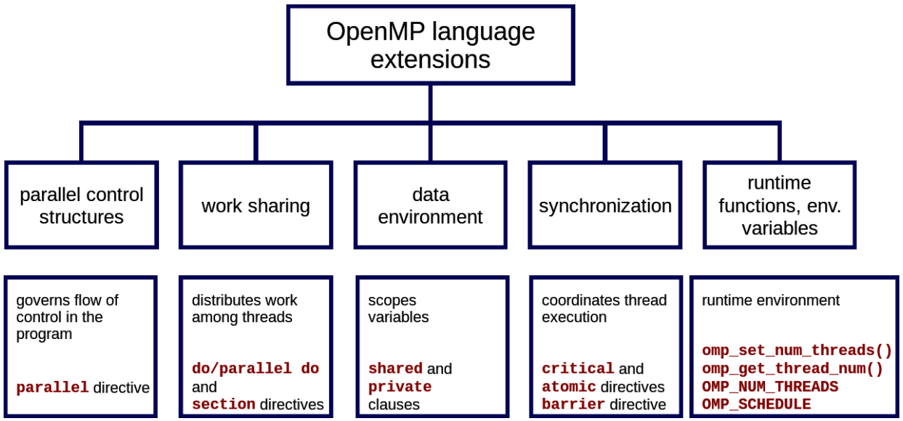
OpenMP: Summary Overview

Slide 34

OpenMP: Performance Tips...
Avoid serialization !
Avoid using #pragma omp parallel for before loop
- Cane have significant overhead
-Thread creation and scheduling is not free!!
- Try for broader parallelism
-One #pragma omp parallel, multiple #pragma omp for
- Always try to parallelize the other most loop
Use reduction whenever possible
Minimize I/O
Minimize critical
- Use atomic instead of critical where possible

Slide 35


Thank you for your attention !

